Slide 1
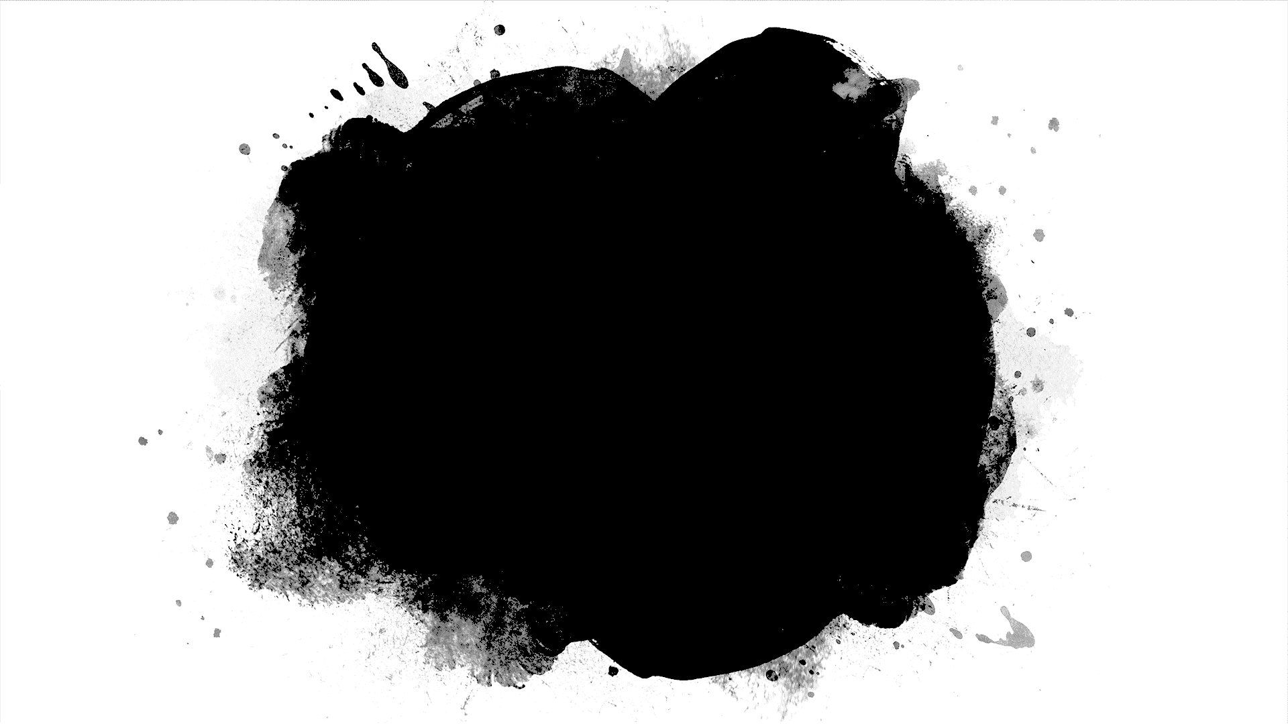
DriverPass System Analysis
Sylvia Kim
Notes:
Hello, my name is Sylvia Kim, and I’ll be demonstrating a slideshow of my DriverPass System Analysis Report.

Slide 2
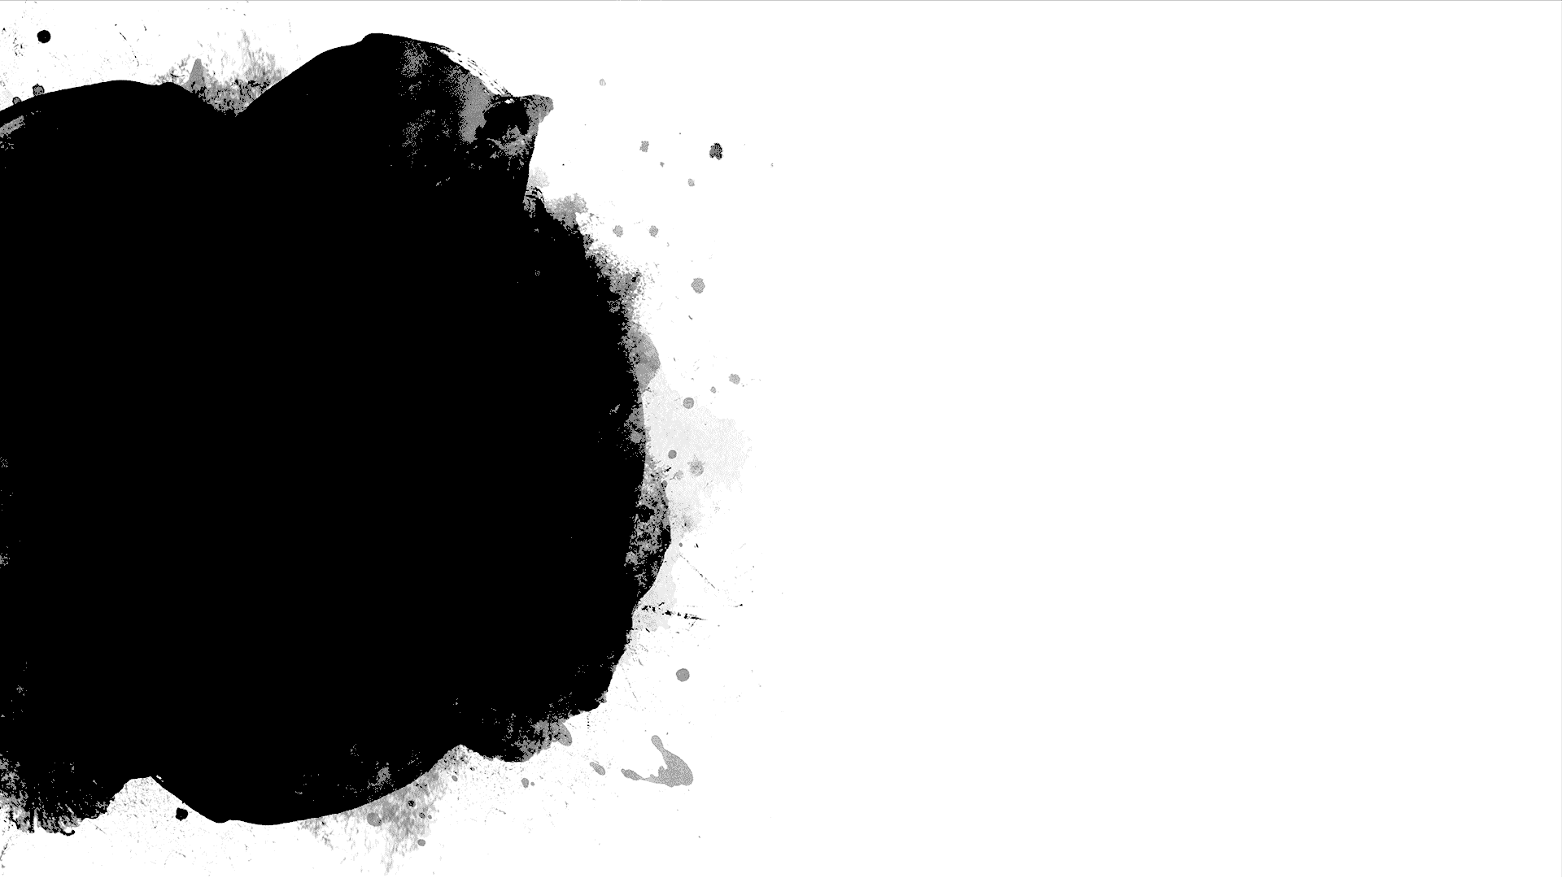
System Requirements
Functional Requirements
Confirm appointment
Edit/cancel appointments
Non-Functional Requirements
Security
Portability
Notes:
We start of with the system requirements needed within DriverPass. Some functional requirements needed would be the confirmation of the appointments the customers had chosen. This includes the date and time. Then they should also be able to edit or cancel their appointments if needed to adjust their schedule. The non-functional requirements would be the security of the system, so the information the customer will be inputting will be secured within the online network. The portability of the system. This will ensure that the online store can be accessed on a mobile device.

Slide 3
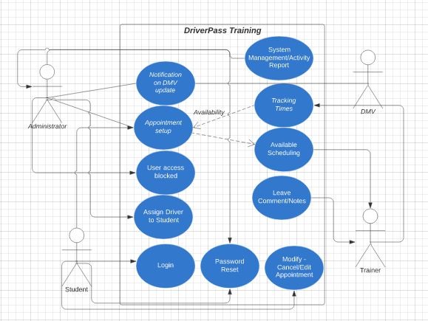
Use Case Diagram
[Insert your use case diagram here.]
Notes:
Next, we go onto Use Case Diagram. The different stick figures in the image represents the different people who’ll be users within this system. We have the administrator – who’s in charge of the whole system management and updates, the DMV for any updates, student who will be applying and creating an account to participate in the training, and the trainer who will be teaching the student. The blue bubbles represent the different things each person will have access to. For example, the student can login, make an appointment, and modify it. I made sure that everything was included in this diagram to represent the flow of how the system would work. I made sure the password reset was available for both the administrators and student like they had asked for. As well as the user access block being available to the administrators for security purposes.

Slide 4
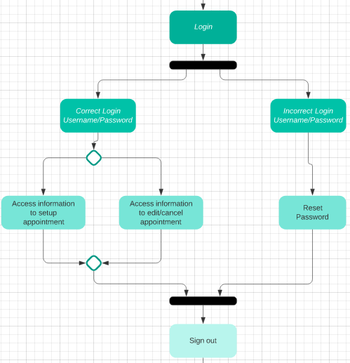
Activity Diagram
Notes:
Here I have what is called an Activity Diagram. I had decided to illustrate to you the process of a student logging into their account. I was able to account DriverPass’s needs in my design by implementing the password reset option. First, we have the correct or incorrect username and password. If all information is correct, then the student will be able to log in. However, if any of the necessary information to log in is incorrect, then the student will be sent to the reset password screen. This is to ensure all information within the account is protected and making sure that the information is only available to the correct user.

Slide 5
Security
Username/Password
Disabled if too many attempts
Cloud
Secure Network
Notes:
Security is major when it comes to anything dealing with private information from a client or business. In order to keep all information secured, we require a username and password for everyone who wants to access the system. This will further strengthen security for students when they log into their account. If any unapproved users were trying to access an account, it will temporarily disable/lock it. After that, the system will prompt the user to do a password reset to access their account. For security, especially on an online platform, running the system through a cloud and a secured network will tighten the security needed from any potential threats or attacks.

Slide 6
System Limitations
System Updates
Updates on Availability
Notes:
Some system limitations I saw in my design would be the system maintenance updates. This can cause a temporary shutdown or delay to the system which may hinder some students when trying to update or create an appointment. Another limitation would be the speed of which the system will update. For example, the updates of available appointment times and dates. If the update is too slow, we may have issues with double booking from two separate students. We need to ensure that there is real-time feedback on what’s available to limit this from occurring.

